Slide 1

A TASTE OF CHICAGO
Scrape Chicago Restaurants Information from Tripadvisor Using Python Selenium

Slide 2
Project Purpose
Scrape restaurants information including name, price range, location, score, review, number of comments, cuisine features from Tripadvisor
Create a visual analysis to explore top restaurants characteristics

Slide 3
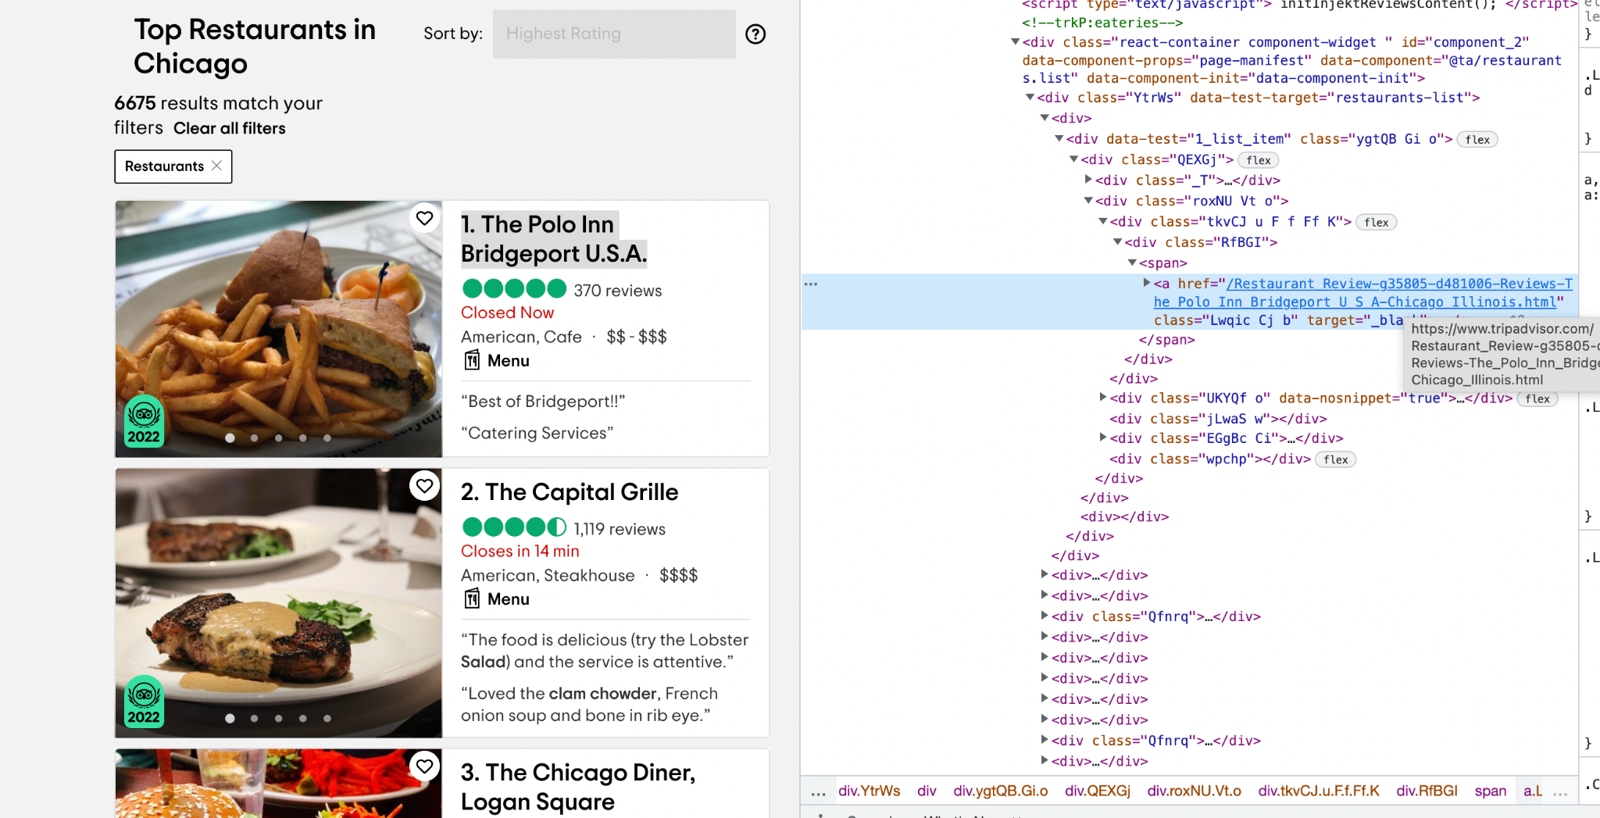
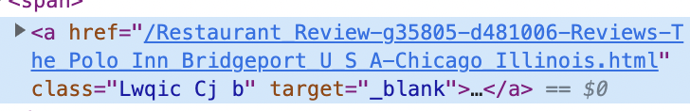
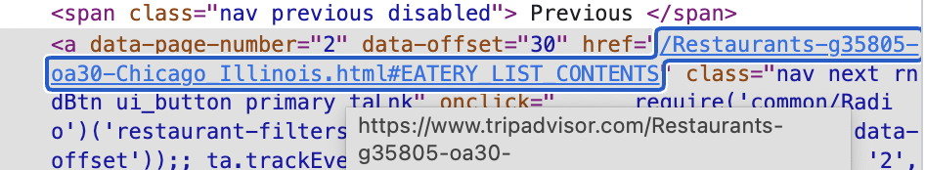
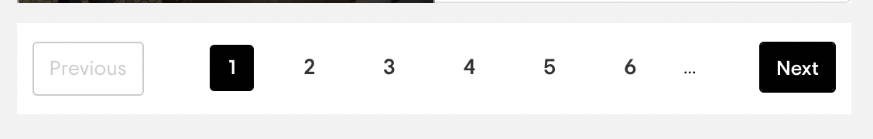
Collect URLS of Top 120 Restaurants
Use selenium to catch all <a href> attributes under <div> with the data-test-target “restaurant” list, then use .click() to move to the next page

Slide 4
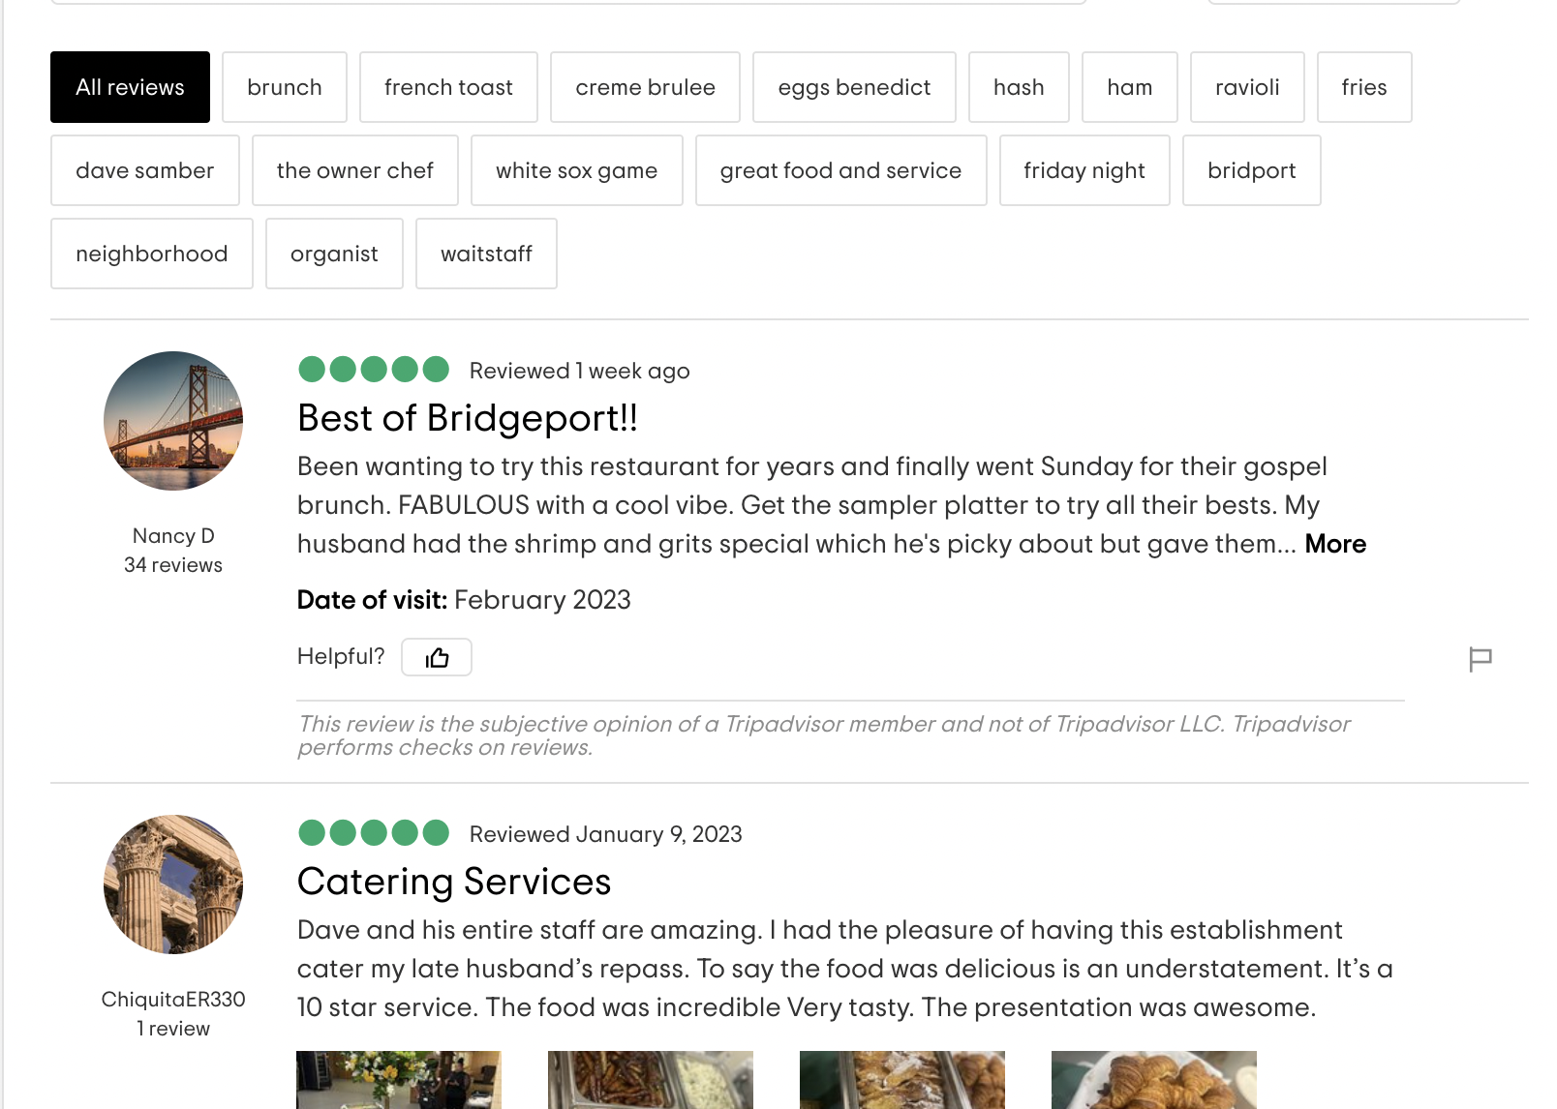
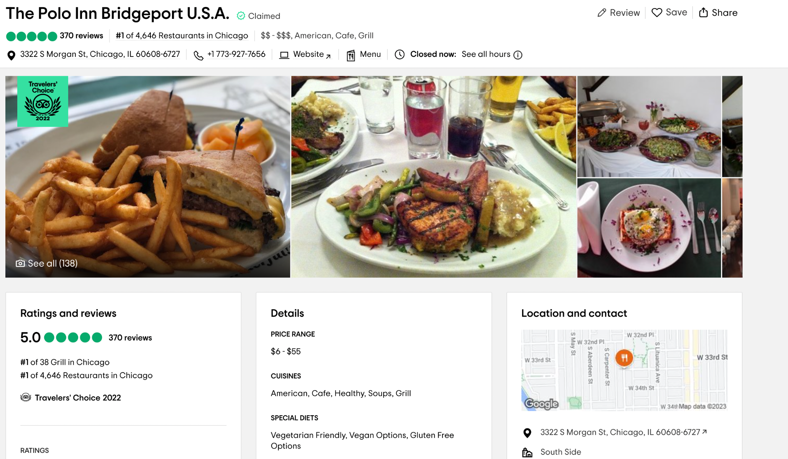
Open Each Page for Individual Information
Name
Location
Feature
Reviews
Score
Number of reviews
Location

Slide 5
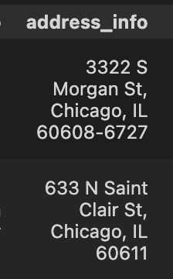
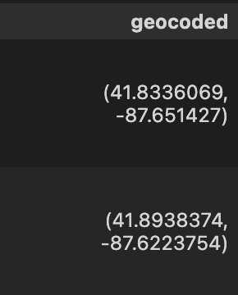
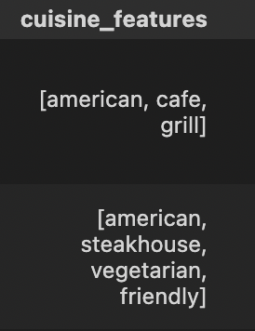
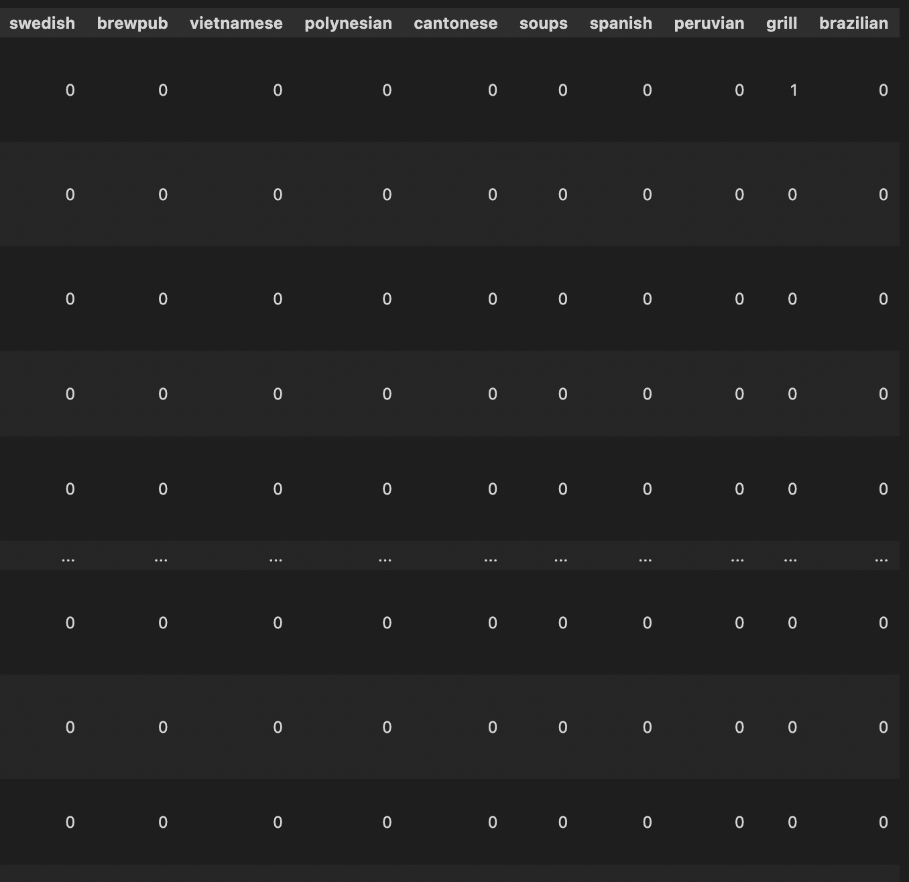
Data cleaning
Unlist tuples and list
Using regex to extract restaurant score, number of reviews
Conduct one-hot-encoding on cuisine features
Geocoding on the restaurants addresses using Google Cloud Map API
Geocoding
One-hot-encoding

